Slide 1
Operating System (CS-115) Class
On
Memory Management
Department of Computer Science and Engineering,
Chitkara University, Punjab
Dr. Prabhjot Chahal Operating System - 22CS005

Slide 2
Index
Background
Logical versus Physical Address Space
Swapping
Contiguous Allocation
Segmentation
Paging
Segmentation with Paging
Prabhjot Chahal Operating System
2

Slide 3
Background
Program must be brought into memory and placed within a process for it to be executed.
Input queue – collection of processes on the disk that are waiting to be brought into memory for execution.
User programs go through several steps before being executed.

Slide 4
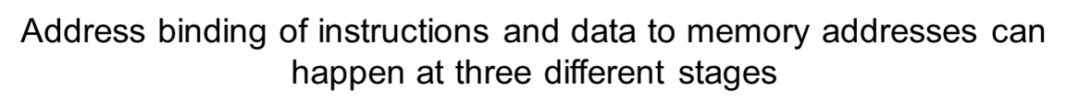
Binding of Instructions and Data to Memory
Compile time: If memory location known a priori, absolute code can be generated; must recompile code if starting location changes.
Load time: Must generate relocatable code if memory location is not known at compile time.
Execution time: Binding delayed until run time if the process can be moved during its execution from one memory segment to another. Need hardware support for address maps (e.g., base and limit registers).

Slide 5
Dynamic Loading
Routine is not loaded until it is called
Better memory-space utilization; unused routine is never loaded.
Useful when large amounts of code are needed to handle infrequently occurring cases.
No special support from the operating system is required implemented through program design.

Slide 6
Overlays
Keep in memory only those instructions and data that are needed at any given time.
Needed when process is larger than amount of memory allocated to it.
Implemented by user, no special support needed from operating system, programming design of overlay structure is complex

Slide 7
Introduction to Memory Management
The term Memory can be defined as a collection of data in a specific format. It is used to store instructions and processed data. The memory comprises a large array or group of words or bytes, each with its own location.
Memory Management
In a multiprogramming computer, the operating system resides in a part of memory and the rest is used by multiple processes. The task of subdividing the memory among different processes is called memory management.
Memory management is a method in the operating system to manage operations between main memory and disk during process execution. The main aim of memory management is to achieve efficient utilization of memory.

Slide 8
Requirement of Memory Management
Allocate and de-allocate memory before and after process execution.
To keep track of used memory space by processes.
To minimize fragmentation issues.
To proper utilization of main memory.
To maintain data integrity while executing of process.

Slide 9
Logical vs. Physical Address Space
The concept of a Logical address space that is bound to a separate physical address space is central to proper memory management.
Logical address – generated by the CPU; also referred to as virtual address.
Physical address – address seen by the memory unit.
Logical and physical addresses are the same in compile-time and load-time address-binding schemes; logical (virtual) and physical addresses differ in execution-time address-binding scheme.

Slide 10
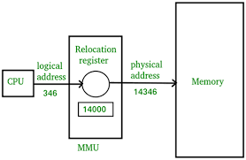
Memory-Management Unit (MMU)
Hardware device that maps virtual to physical address.
In MMU scheme, the value in the relocation register is added to every address generated by a user process at the time it is sent to memory.
The user program deals with logical addresses; it never sees the real physical addresses.

Slide 11
Swapping
A process can be swapped temporarily out of memory to a backing store, and then brought back into memory for continued execution.
Backing store – fast disk large enough to accommodate copies of all memory images for all users; must provide direct access to these memory images.
Roll out, roll in – swapping variant used for priority-based scheduling algorithms; lower-priority process is swapped out so higher-priority process can be loaded and executed.
Major part of swap time is transfer time; total transfer time is directly proportional to the amount of memory swapped.
Modified versions of swapping are found on many systems, i.e., UNIX and Microsoft Windows.

Slide 12
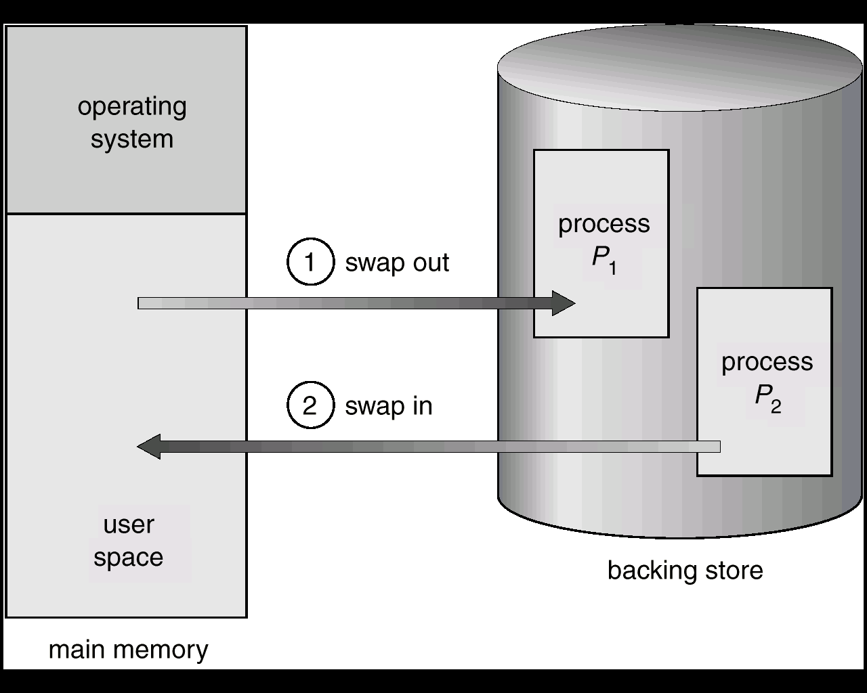
Schematic View of Swapping

Slide 13
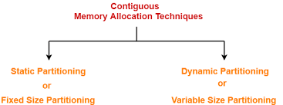
Contiguous Memory Allocation
In the Contiguous Memory Allocation, each process is contained in a single contiguous section of memory. In this memory allocation, all the available memory space remains together in one place which implies that the freely available memory partitions are not spread over here and there across the whole memory space.
The memory can be divided either in the fixed-sized partition or in the variable-sized partition in order to allocate contiguous space to user processes

Slide 14
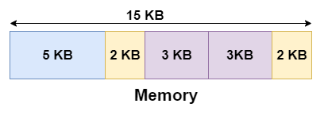
Fixed-size Partition Scheme
In this scheme, the system divides the memory into fixed-size partitions. The partitions may or may not be the same size. The size of each partition is fixed as indicated by the name of the technique and it cannot be changed.
Let's take an example of fixed size partitioning scheme, we will divide a memory size of 15 KB into fixed-size partitions:

Slide 15
Advantages and Disadvantages of Fixed-size Partition Scheme
Advantages
This scheme is simple and is easy to implement
It supports multiprogramming as multiple processes can be stored inside the main memory.
Management is easy using this scheme
Disadvantages
Internal Fragmentation
Suppose the size of the process is lesser than the size of the partition in that
case some size of the partition gets wasted and remains unused. This wastage
inside the memory is generally termed as Internal fragmentation.
Limitation on the size of the process
If in a case size of a process is more than that of a maximum-sized partition then
that process cannot be loaded into the memory.

Slide 16
Advantages and Disadvantages of Fixed-size
Partition Scheme(Cont.)
External Fragmentation
It is another drawback of the fixed-size partition scheme as total unused space by various partitions cannot be used in order to load the processes even though there is the availability of space but it is not in the contiguous fashion.
Degree of multiprogramming is less
In this partition scheme, as the size of the partition cannot change according to the size of the process. Thus the degree of multiprogramming is very less and is fixed.

Slide 17
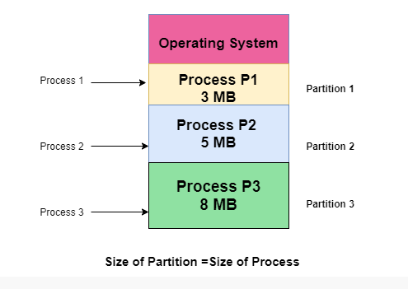
Variable-size Partition Scheme
This scheme is also known as Dynamic partitioning and is came into existence to overcome the drawback i.e. internal fragmentation that is caused by Static partitioning. In this partitioning, scheme allocation is done dynamically.
The size of the partition is not declared initially. Whenever any process arrives, a partition of size equal to the size of the process is created and then allocated to the process. Thus the size of each partition is equal to the size of the process.
As partition size varies according to the need of the process so in this partition scheme there is no internal fragmentation.

Slide 18
Advantages and Disadvantages of Variable-size Partition Scheme
Some Advantages of using this partition scheme are as follows
No Internal Fragmentation : As in this partition scheme space in the main memory is allocated strictly according to the requirement of the process thus there is no chance of internal fragmentation. Also, there will be no unused space left in the partition.
Degree of Multiprogramming is Dynamic : As there is no internal fragmentation in this partition scheme due to which there is no unused space in the memory. Thus more processes can be loaded into the memory at the same time.
No Limitation on the Size of Process : In this partition scheme as the partition is allocated to the process dynamically thus the size of the process cannot be restricted because the partition size is decided according to the process size.

Slide 19
Advantages and Disadvantages of Variable-size Partition Scheme(Cont.)
External Fragmentation
External fragmentation happens when there’s a sufficient quantity of area within the memory to satisfy the memory request of a method. However, the process’s memory request cannot be fulfilled because the memory offered is in a non-contiguous manner.
Difficult Implementation
The implementation of this partition scheme is difficult as compared to the Fixed Partitioning scheme as it involves the allocation of memory at run-time rather than during the system configuration. As we know that OS keeps the track of all the partitions but here allocation and deallocation are done very frequently and partition size will be changed at each time so it will be difficult for the operating system to manage everything.

Slide 20
Dynamic Storage-Allocation Problem
How to satisfy a request of size n from a list of free holes?
Dynamic storage allocation problem
First-fit: Allocate the first hole that is big enough
Best-fit: Allocate the smallest hole that is big enough; must search entire list, unless ordered by size
Produces the smallest leftover hole
Worst-fit: Allocate the largest hole; must also search entire list
Produces the largest leftover hole

Slide 21
Segmentation
Memory-management scheme that supports user view of memory.
A program is a collection of segments. A segment is a logical unit such as:
main program,
procedure,
function,
local variables, global variables,
common block,
stack,
symbol table, arrays

Slide 22
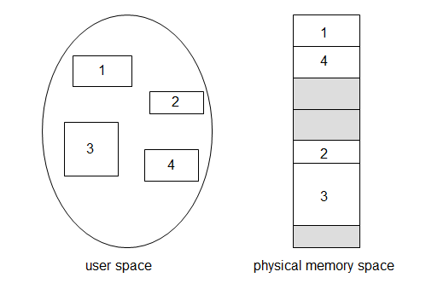
Logical View of Segmentation

Slide 23
Segmentation Architecture
Logical address consists of a two tuple:
<segment-number, offset>,
Segment table – maps two-dimensional physical addresses; each table entry has:
base – contains the starting physical address where the segments reside in memory.
limit – specifies the length of the segment.
Segment-table base register (STBR) points to the segment table’s location in memory.
Segment-table length register (STLR) indicates number of segments used by a program;
segment number s is legal if s < STLR.

Slide 24
Segmentation Architecture (Cont.)
Relocation.
dynamic
by segment table
Sharing.
shared segments
same segment number
Allocation.
first fit/best fit
external fragmentation

Slide 25
Segmentation Architecture (Cont.)
Protection. With each entry in segment table associate:
validation bit = 0 ⇒ illegal segment
read/write/execute privileges
Protection bits associated with segments; code sharing occurs at segment level.
Since segments vary in length, memory allocation is a dynamic storage-allocation problem.
A segmentation example is shown in the following diagram

Slide 26
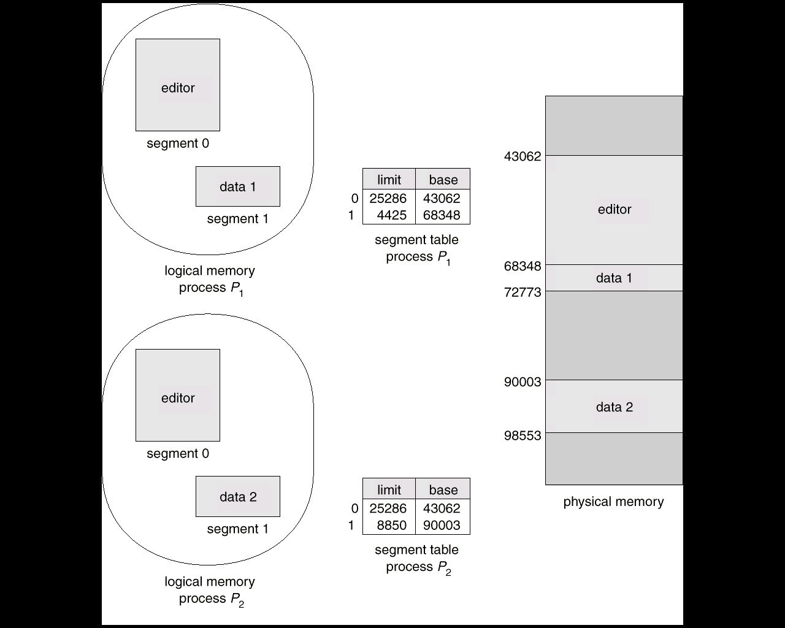
Sharing of segments

Slide 27
Segmentation with Paging – MULTICS
The MULTICS system solved problems of external fragmentation and lengthy search times by paging the segments.
Solution differs from pure segmentation in that the segment-table entry contains not the base address of the segment, but rather the base address of a page table for this segment.

Slide 28
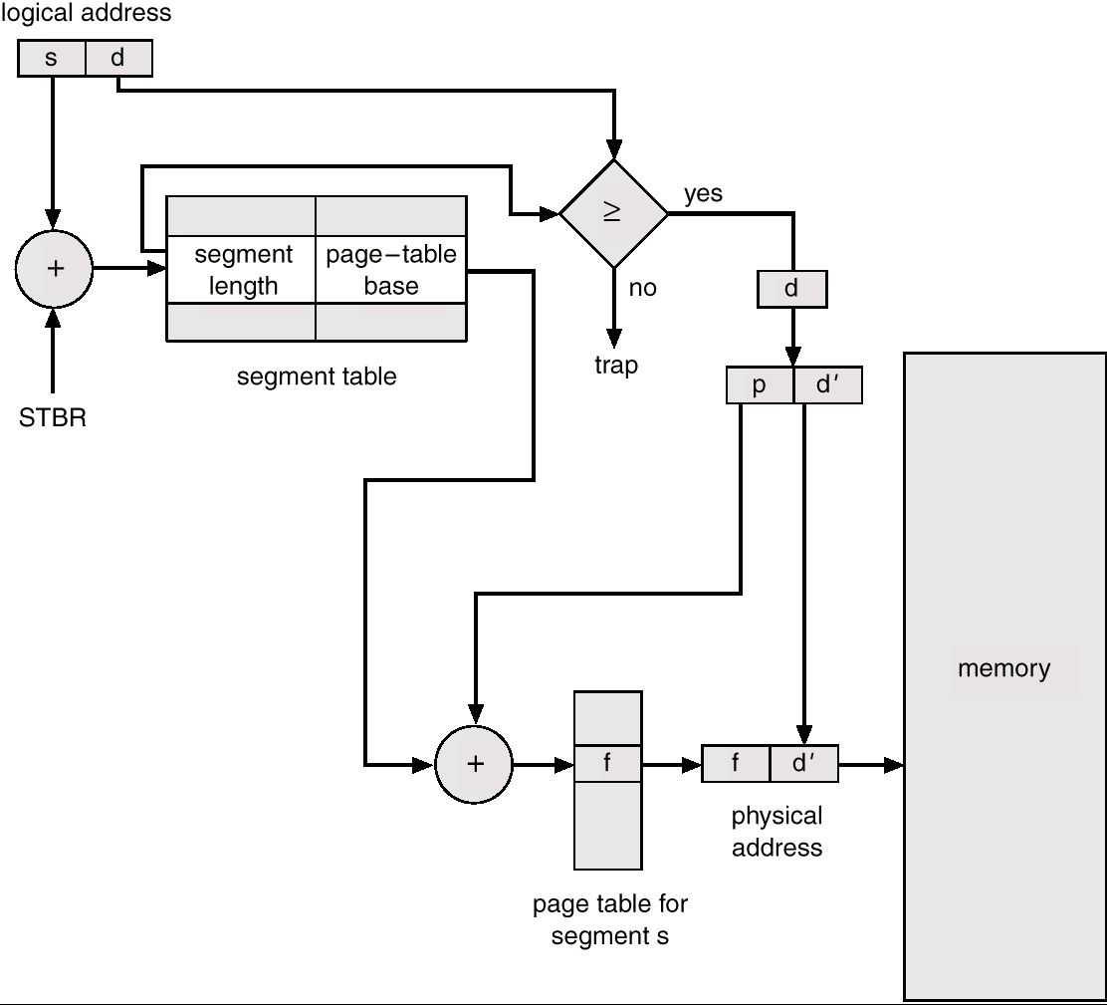
MULTICS Address Translation Scheme

Slide 29
Paging
Physical address space of a process can be noncontiguous;
process allocates physical memory whenever the latter is available
Divide physical memory into fixed-sized blocks called frames
Size is power of 2, between 512 bytes and 16 Mbytes
Divide logical memory into blocks of same size called pages
To run a program of size N pages, need to find N free frames and load program
Backing store likewise split into pages
Set up a page table to translate logical to physical addresses
System keeps track of all free frames

Slide 30
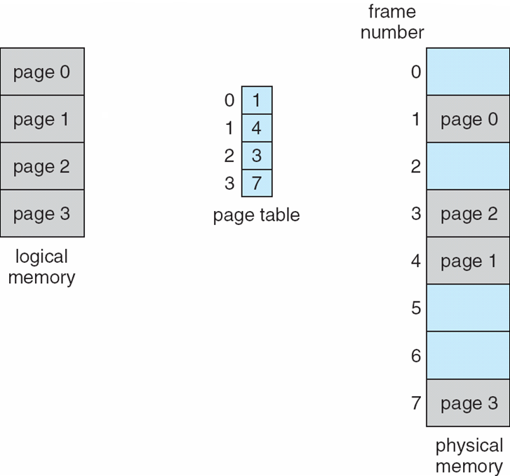
Paging Model of Logical and Physical Memory
Page table to translate logical to physical addresses.
Prabhjot Chahal Operating System

Slide 31
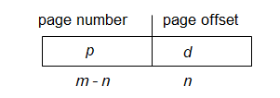
Address Translation Scheme
Address generated by CPU is divided into:
Page number (p) – used as an index into a page table
which contains base address of each page in physical memory
Page offset (d) – offset within a page
combined with base address to define the physical memory address that is sent to the memory unit
For given logical address space 2^{m} and page size 2^{n}
Prabhjot Chahal Operating System

Slide 32
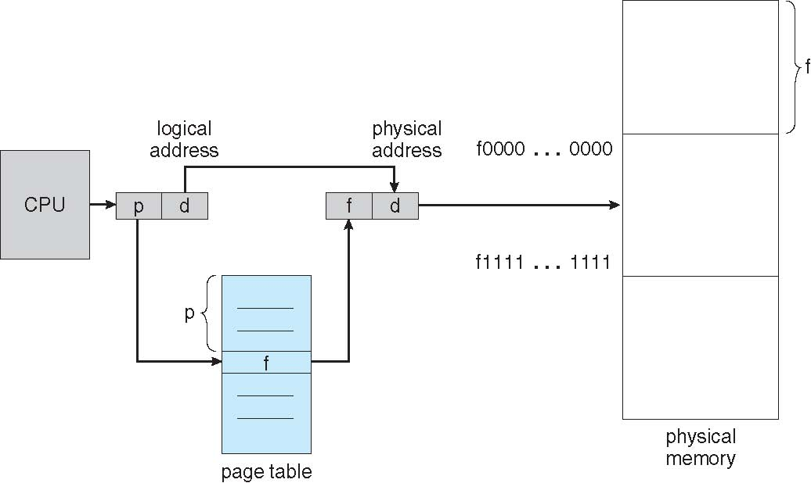
Paging Hardware

Slide 33
Implementation of Page Table
Page table is kept in main memory.
Page-table base register (PTBR) points to the page table.
Page-table length register (PRLR) indicates size of the page table.
In this scheme every data/instruction access requires two memory accesses.
One for the page table and one for the data/instruction.
The two memory access problem can be solved by the use of a special fast-lookup hardware cache called associative registers or translation look-aside buffers (TLBs)

Slide 34
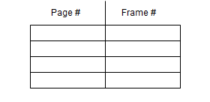
Associative Register
Associative registers – parallel search
Address translation (A´, A´´)
If A´ is in associative register, get frame # out.
Otherwise get frame # from page table in memory

Slide 35
Effective Access Time
Associative Lookup = ε time unit
Assume memory cycle time is 1 microsecond
Hit ration – percentage of times that a page number is found in the associative registers; ration related to number of associative registers.
Hit ratio = α
Effective Access Time (EAT)
EAT = (1 + ε) α + (2 + ε)(1 – α)
= 2 + ε – α

Slide 36
Memory Protection
Memory protection implemented by associating protection bit with each frame.
Valid-invalid bit attached to each entry in the page table:
“valid” indicates that the associated page is in the process’ logical address space, and is thus a legal page.
“invalid” indicates that the page is not in the process’ logical address space.

Slide 37
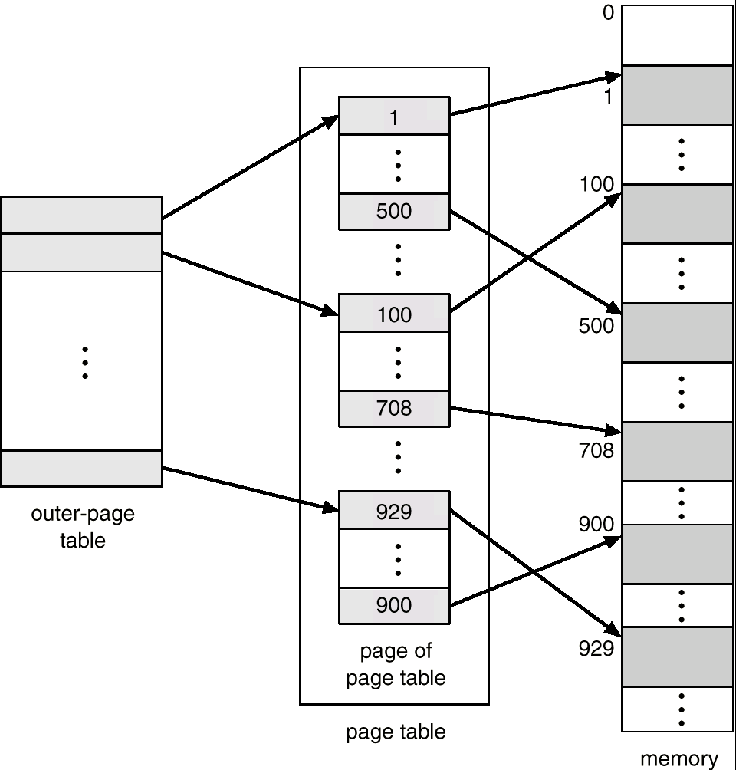
Two-Level Page-Table Scheme

Slide 38

Two-Level Paging Example
A logical address (on 32-bit machine with 4K page size) is divided into:
a page number consisting of 20 bits.
a page offset consisting of 12 bits.
Since the page table is paged, the page number is further divided into:
a 10-bit page number.
a 10-bit page offset.
Thus, a logical address is as follows: where p_{i} is an index into the outer page table, and p₂ is the displacement within the page of the outer page table.

Slide 39
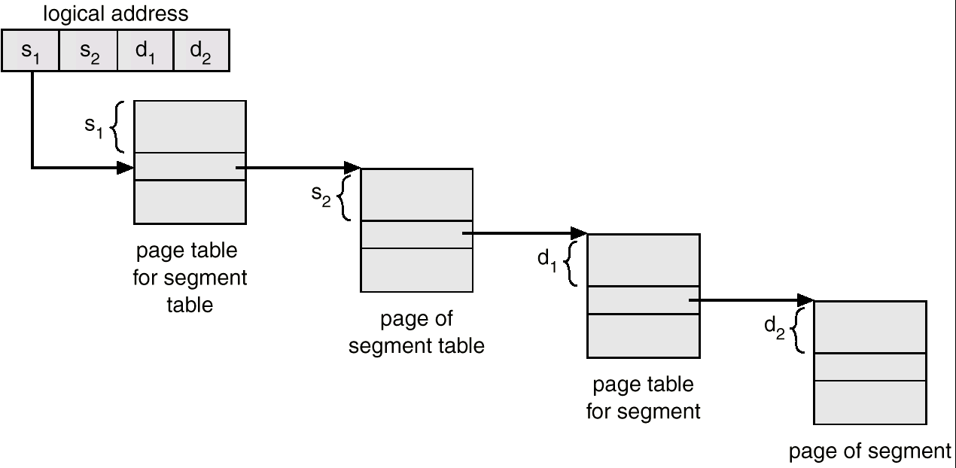
Address-Translation Scheme
Address-translation scheme for a two-level 32-bit paging architecture

Slide 40
Multilevel Paging and Performance
Since each level is stored as a separate table in memory, covering a logical address to a physical one may take four memory accesses.
Even though time needed for one memory access is quintupled, caching permits performance to remain reasonable.
Cache hit rate of 98 percent yields:
effective access time = 0.98 x 120 + 0.02 x 520
= 128 nanoseconds. which is only a 28 percent slowdown in memory access time.

Slide 41
Inverted Page Table
One entry for each real page of memory.
Entry consists of the virtual address of the page stored in that real memory location, with information about the process that owns that page.
Decreases memory needed to store each page table, but increases time needed to search the table when a page reference occurs.
Use hash table to limit the search to one — or at most a few — page-table entries.

Slide 42
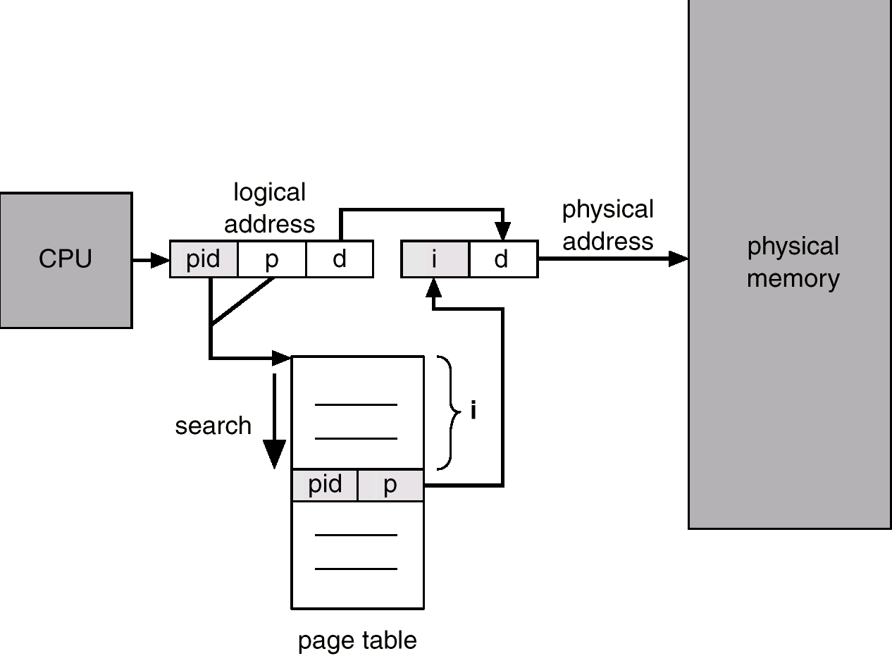
Inverted Page Table Architecture

Slide 43
Shared Pages
Shared code
One copy of read-only (reentrant) code shared among processes (i.e., text editors, compilers, window systems).
Shared code must appear in same location in the logical address space of all processes.
Private code and data
Each process keeps a separate copy of the code and data.
The pages for the private code and data can appear anywhere in the logical address space.

Slide 44
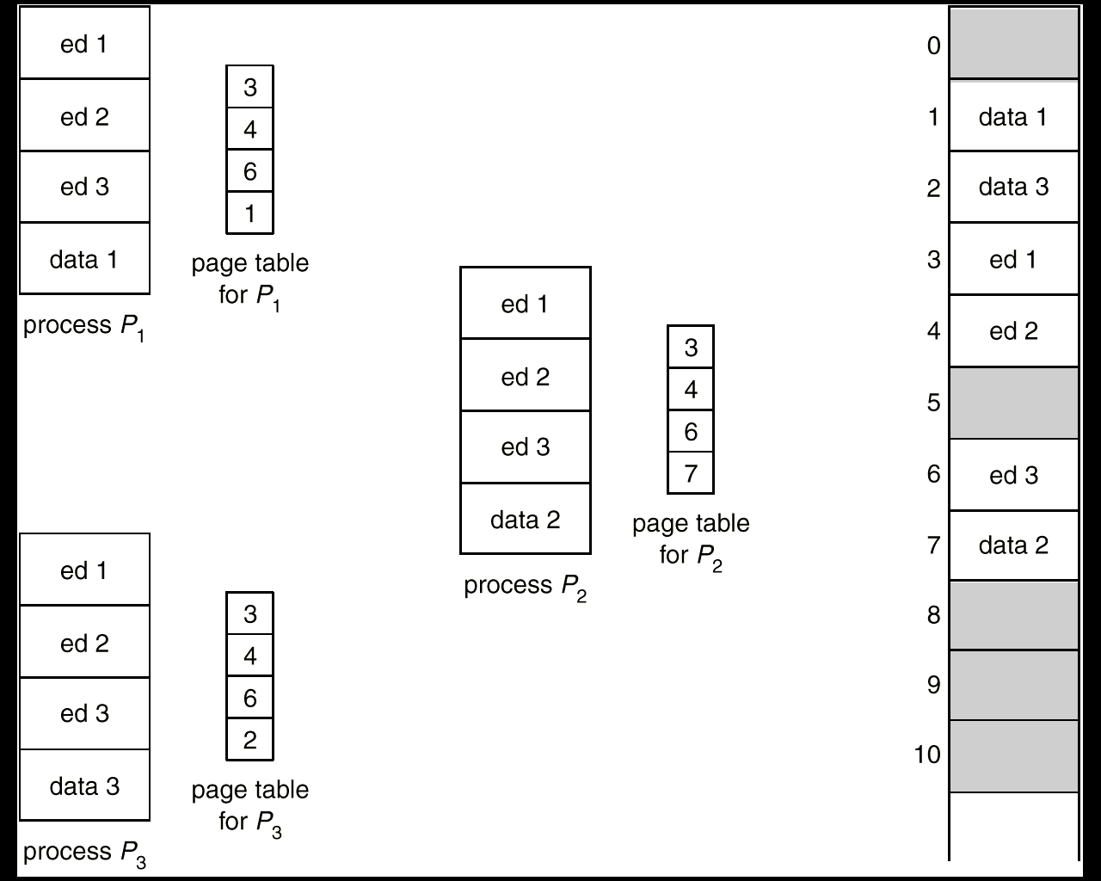
Shared Pages Example

Slide 45
Segmentation with Paging
Key idea:
Segments are splitted into multiple pages.
Each page is loaded into frames in the memory.

Slide 46
Segmentation with Paging(Cont.)
Pure segmentation is not being used in many of the operating systems
• In Segmented Paging, the main memory is divided into variable size segments which are further divided into fixed size pages.
1. Pages are smaller than segments.
2. Each Segment has a page table which means every program has multiple page tables.
3. The logical address is represented as Segment Number (base address), Page number and page offse

Slide 47
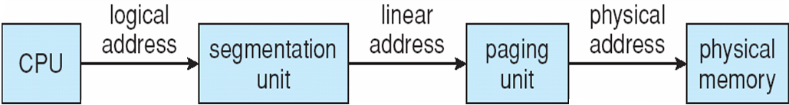
Logical to Physical Address Translation in Pentium

Slide 48
Advantages and Disadvantages of Segmented Paging
Advantages of Segmented Paging
• It reduces memory usage.
• Page table size is limited by the segment size
• Segment table has only one entry corresponding to one actual segment
• External Fragmentation is not there
• It simplifies memory allocation.
Disadvantages of Segmented Paging
• Internal Fragmentation will be there.
• The complexity level will be much higher as compare to paging.

Slide 49
Thank You
Prabhjot Chahal Operating System

